Slide 1
Tableau Capstone Project
Feb. 2022
Made by- Shubham Gupta

Slide 2
COVID 19 Dataset
Context:
A new coronavirus designated 2019-nCoV was first identified in Wuhan, the capital of China's Hubei province.
The virus has shown evidence of human-to-human transmission
As of 30 January 2020, approximately 8,243 cases have been confirmed.
Content:
This dataset contains historical data on weekly number of new reported COVID cases and deaths worldwide in 2020.
Source of Data:
https://www.kaggle.com/codebreaker619/covid-19-dataset

Slide 3
Problem Statements
Worldwide Situation of Covid 19.
Total confirmed case /deaths by different countries.
Weekly Confirmed cases/deaths.
Comparison of different regions by cases/deaths in different months.
Top 10 Infected countries.

Slide 4
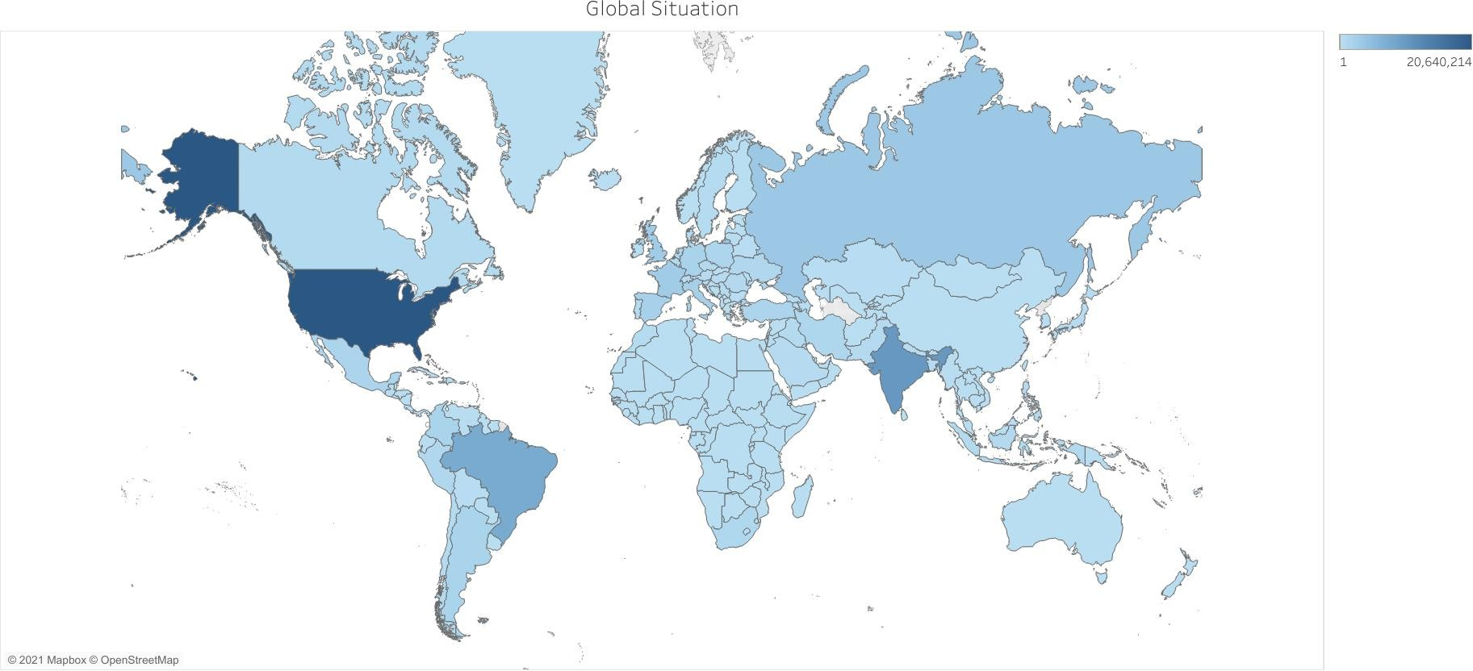

Slide 5
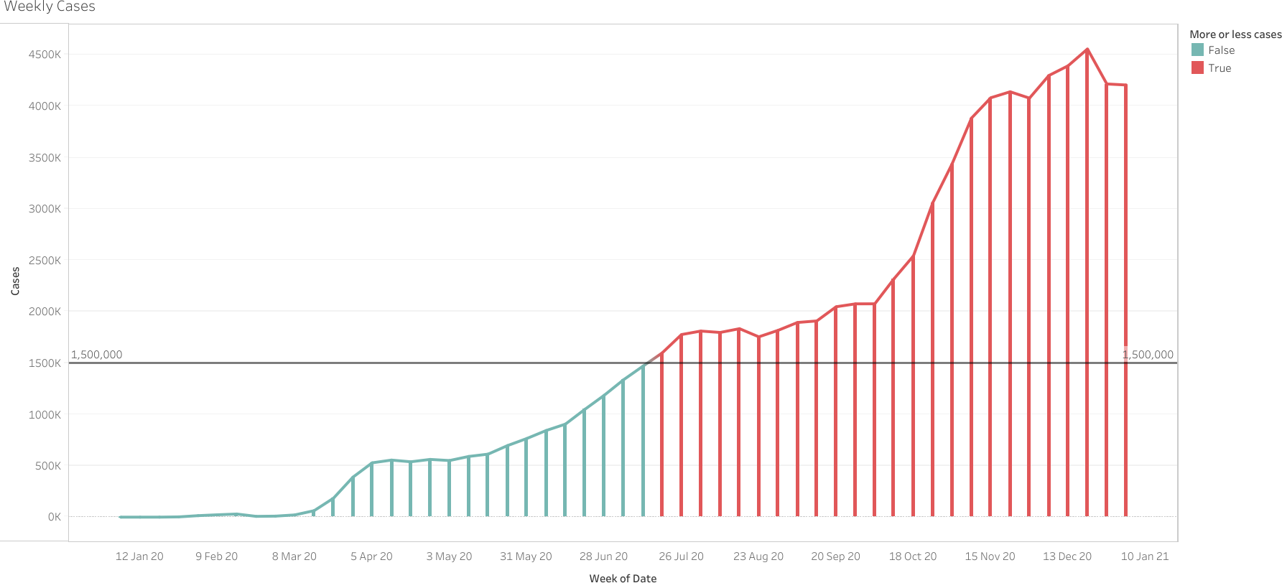

Slide 6
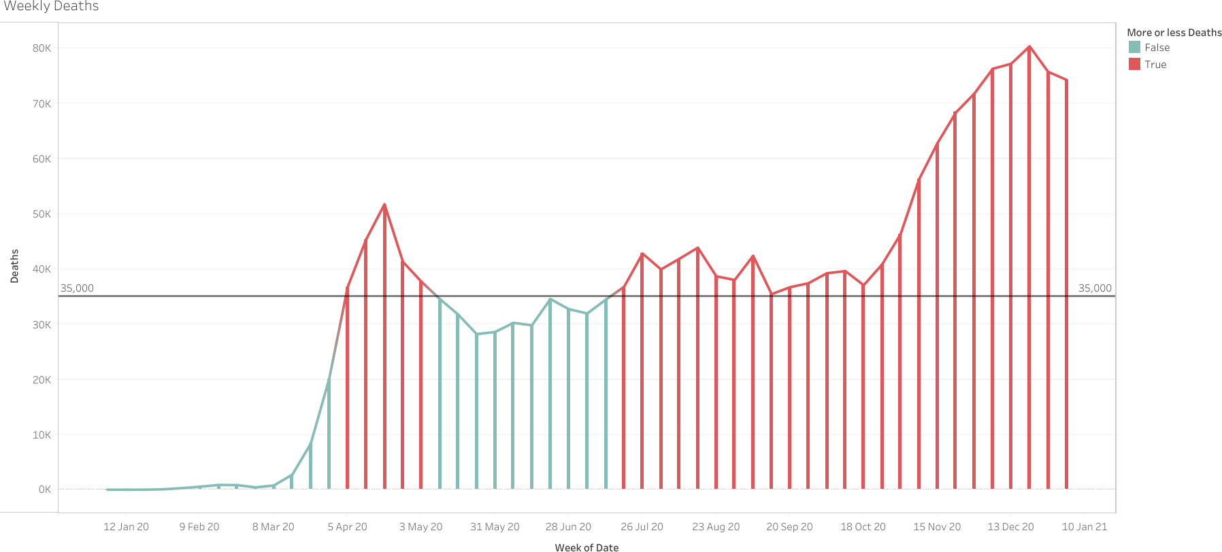

Slide 7
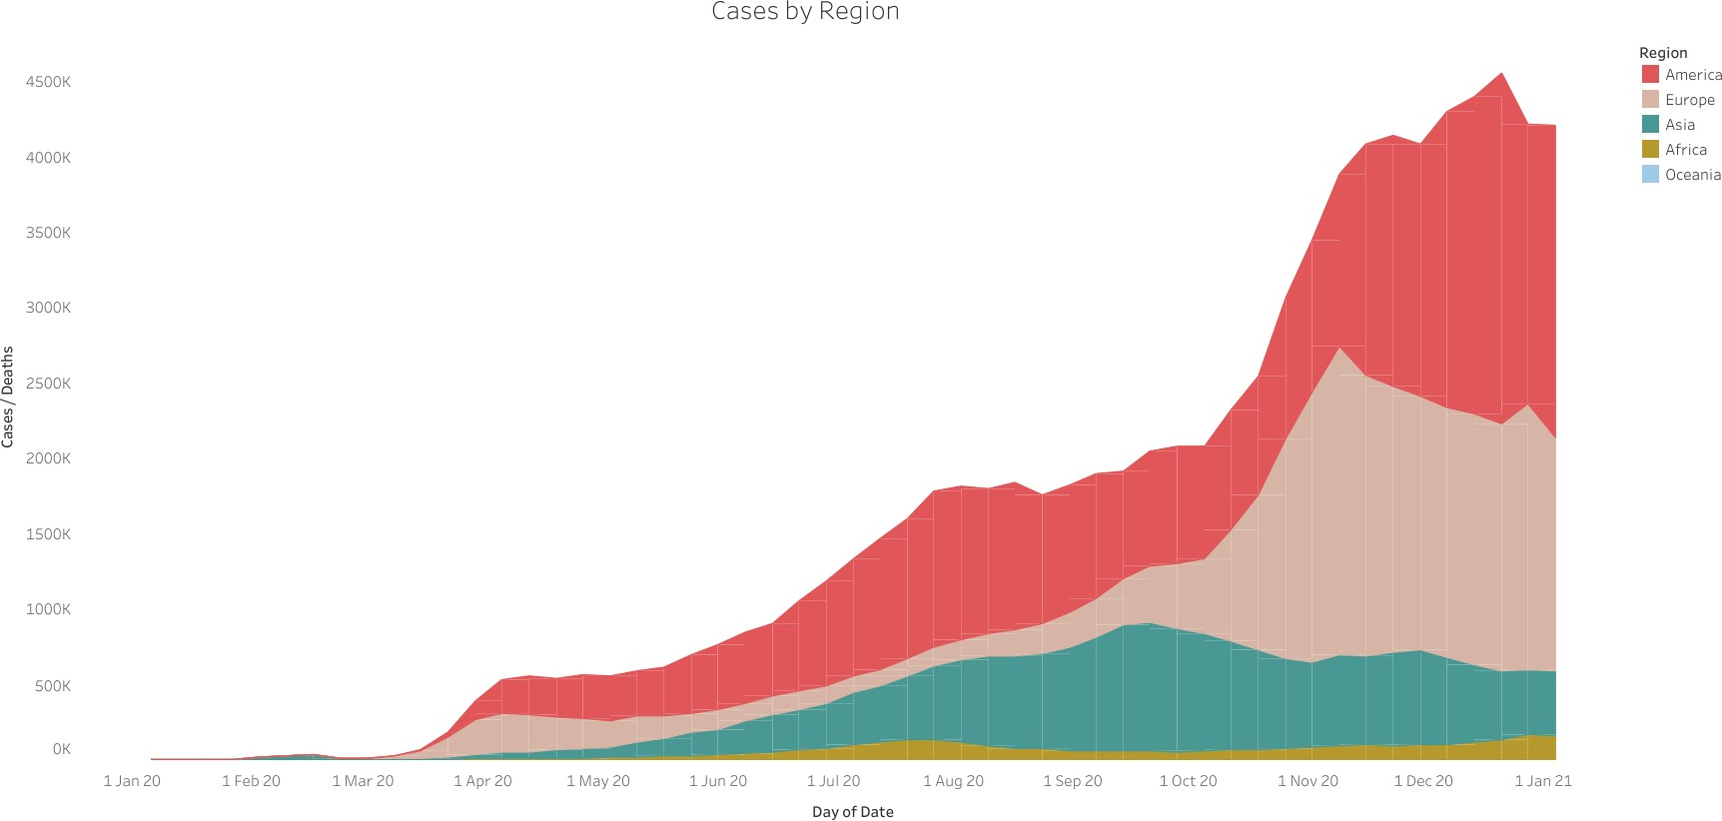

Slide 8
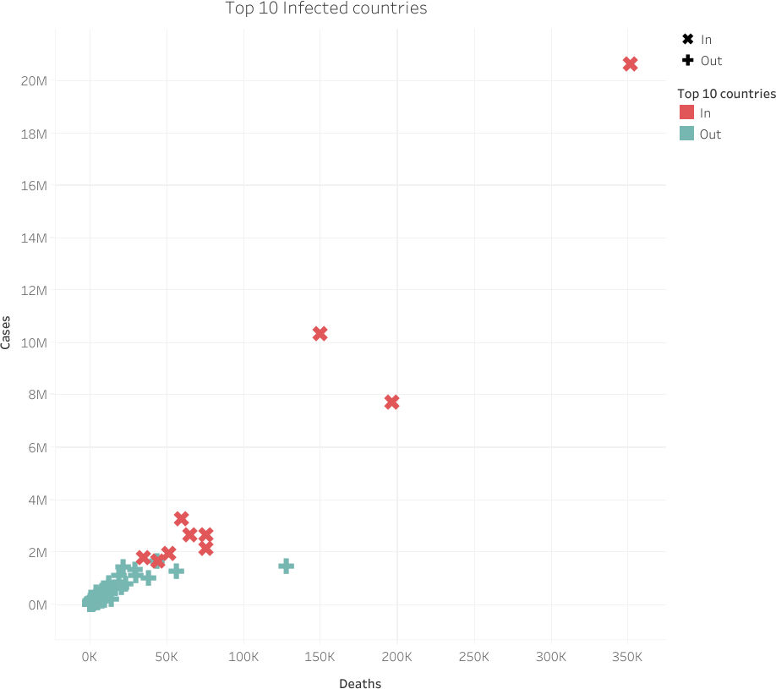

Slide 9
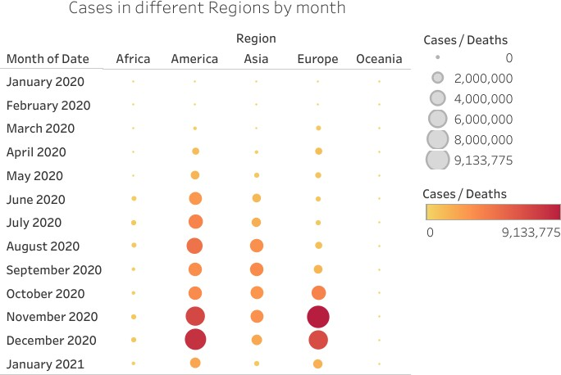

Slide 10
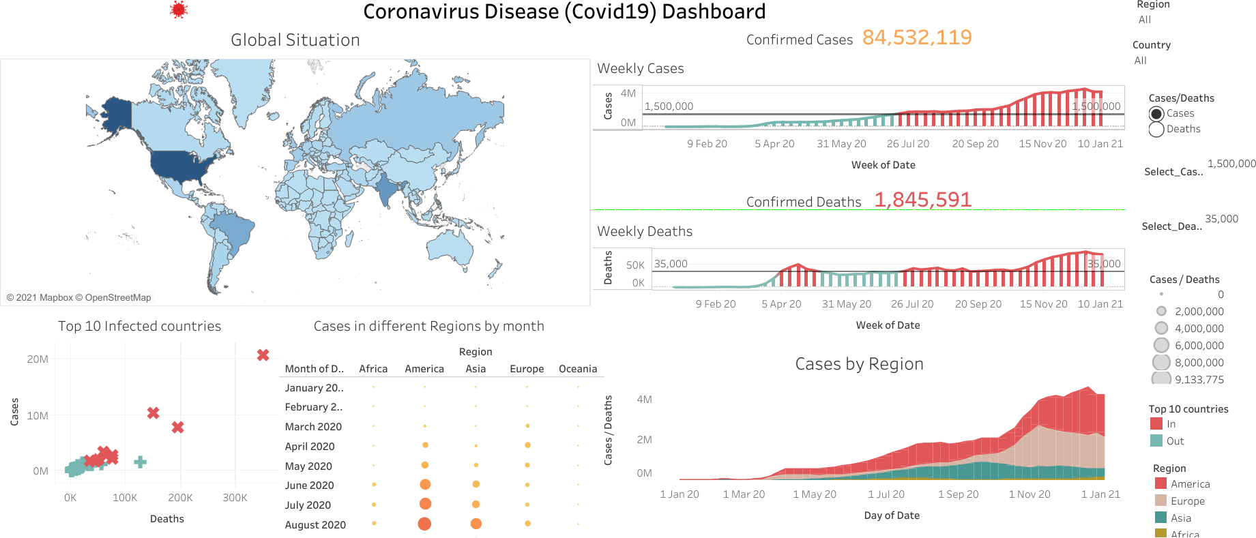

Slide 11
Summary of the project
Coronavirus disease (COVID-19) is an infectious disease caused by a newly discovered coronavirus. Most people infected with the COVID-19 virus will experience mild to moderate respiratory illness and recover without requiring special treatment.
There are 8,45,32,119 confirmed COVID-19 Cases and 18,45,591 death across 213
countries and regions. (As of Jan 4, 2021)
The United States has passed the peak on coronavirus cases which is 2,06,40,214 and 3,51,590 Deaths.
India features at the 2nd position, with 1,03,40,469 positive cases & 1,49,649 Deaths.
Most of the cases have recorded in December 2020.

Slide 12
Conclusion
With the help of this dashboard, it become very easy to know the weekly data of COVID-19 cases & deaths in particular country. We don’t need to search the data in 1000’s rows. Analyzing the data is very easy. Multiple charts are joined to the main dashboard in graphical representation.
The outcome helps us to know the cases & deaths in different prospective with respect to months, countries, regions etc.
We can classify this data from dashboard.

Slide 13
Thank you

